Slide 1

Shell Hydrogen Proposal
Targeting Heavy-Duty Truck Fleets
Notes:
Hi, my name is Alex and this is our proposal for the Shell Hydrogen project of Stanford’s Cleantech Hackathon, specifically targeting heavy-duty trucks. Please note that although we’ve done our best to keep this presentation concise, we don’t have time to cover everything and so more information will be provided in the appendix.

Slide 2




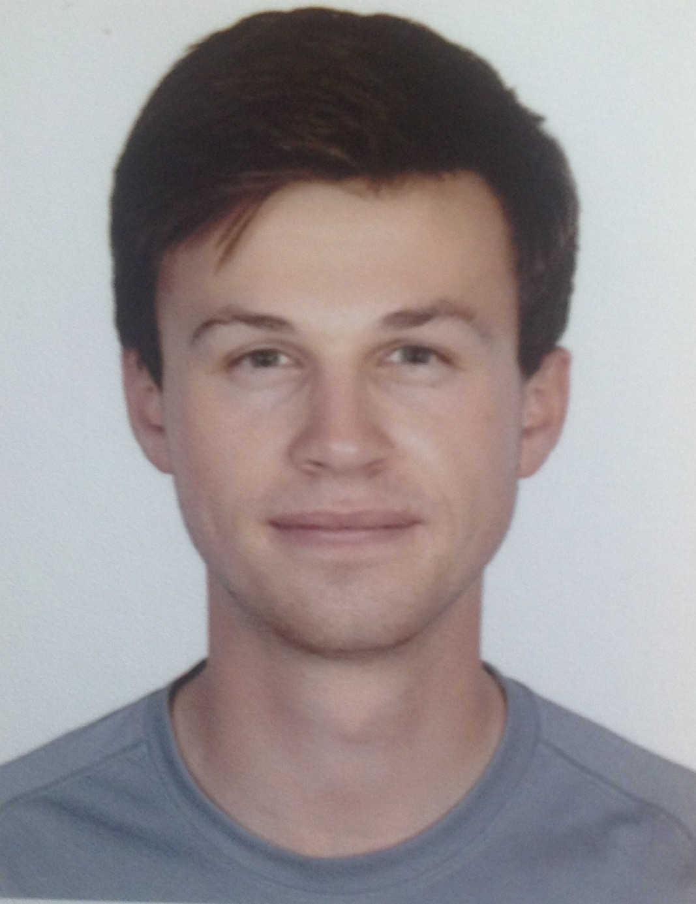
1.
About Us
The French-Canadian Entente
Chloe
Bolongaro
Alex
Koen
William
Navarro
Gaetan
Vervaele
UBC - Vancouver, Canda
UBC - Vancouver, Canda
IFP School - Paris, France
IFP School - Paris, France
Notes:
About us: we are the French-Canadian Entente, and what’s cool is that Chloe and I live in Vancouver, Canada, but William and Gaetan, who we met online, live in Paris. We’ve made this entire project in the last week with a 9 hour time difference and 5000 miles apart. We think it would make a good advertisement for zoom

Slide 3
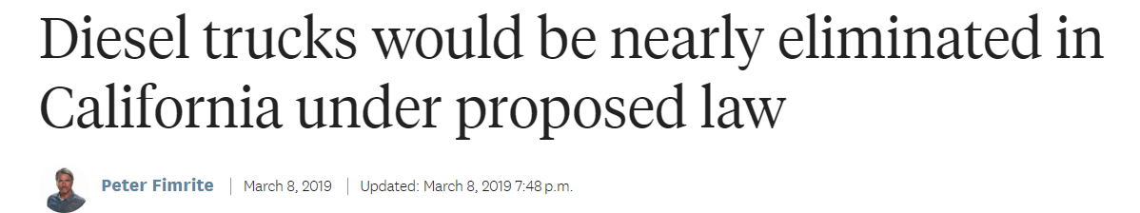
2.
“The bill, by state Sen. Nancy Skinner, D-Berkeley, would direct the California Air Resources Board to require a 40 percent reduction in diesel emissions by 2030 and an 80 percent reduction by 2050, cuts that experts say would not be possible without a major overhaul of the trucking industry.”
https://sd09.senate.ca.gov/news/20190311-diesel-trucks-would-be-nearly-eliminated-california-under-proposed-law
Notes:
California is currently undergoing drastic changes to try and meet their climate goals. For example, a recent bill pictured here was proposed that would mandate a 40 percent reduction in diesel emissions in the state by 2030.

Slide 4
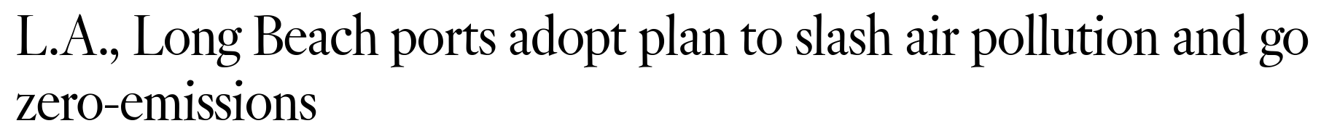
3.
“The nation’s largest port complex approved a plan Thursday to slash air pollution by encouraging the phase-out of diesel trucks in favor of natural gas and, ultimately, zero-emissions trucks and cargo-handling equipment over the next two decades.”
https://cleanairactionplan.org/documents/final-2017-clean-air-action-plan-update.pdf
Notes:
As another example, in 2017 the LA and Long Beach ports vowed to replace all of their diesel trucks in favour of zero-emissions vehicles.

Slide 5
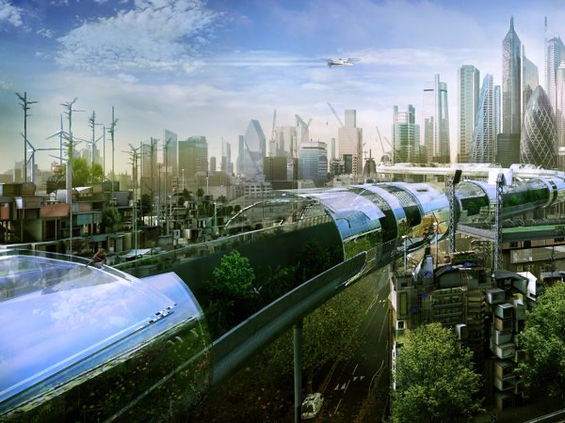

4.
This is California in the future.
Notes:
At this rate, it looks like this is what California is going to look like is near future.

Slide 6
5.
But we’re not there yet. Investments in clean technology will be necessary.
But we’re not there yet. Investments in clean technology will be necessary.
Notes:
But we’re not there yet…
Large investments in clean technology will be necessary.

Slide 7
6.
HEAVY-DUTY TRUCK FLEETS
90% of heavy-duty trucks are owned by trucking companies, not drivers
Trucking companies are more able to invest in new technology.
Why investing in heavy-duty trucks makes sense.
RIDE-SHARING FLEETS
Vehicles are owned by the drivers, not the companies.
Drivers are less able to invest in new technology.
https://www.ooida.com/MediaCenter/trucking-facts.asp
Notes:
We were asked to propose a techno-business opportunity for Shell, targeting either heavy-duty trucks or ride-sharing fleets. To us, it makes more sense to invest in heavy-duty trucks, because 90% of trucks are owned by large companies who have more money to invest in novel technology. However, because ride-sharing vehicles are typically owned by the drivers themselves, they have less money to invest. As a result, we decided to investigate zero-emissions, heavy-duty trucks.

Slide 8
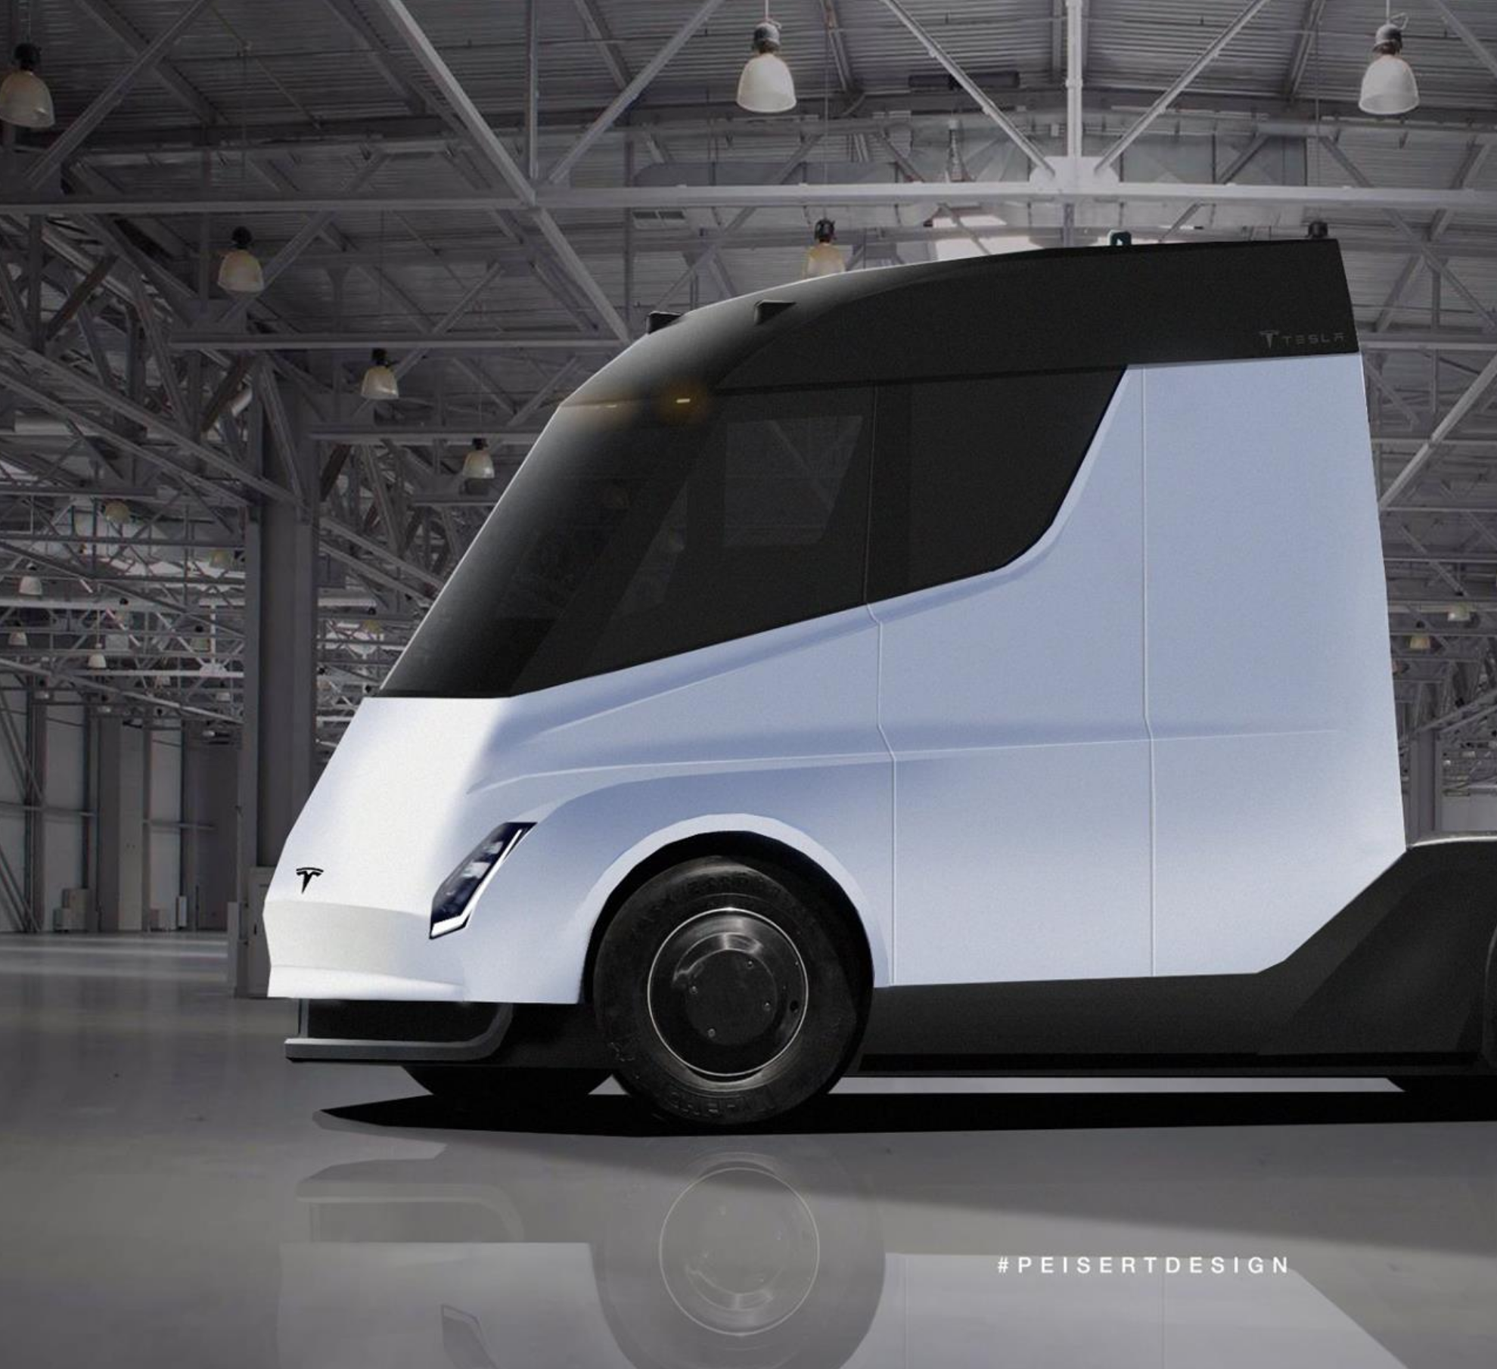
7.
Battery electric trucks are not the solution.
Reduced payload
Long charging times and larger fleets
Heavy batteries in BEV trucks result in a reduced payload capacity of approximately 19%.
BEV trucks required large batteries (600 — 960 kWh) and have long charging times, necessitating increased fleet size.
Path to hydrogen competitiveness. A cost perspective, Hydrogen Council & https://www.fch.europa.eu
Notes:
Unfortunately, battery electric trucks like the Tesla Semi pictured on the right are not the solution. They require large, expensive batteries with increased charging times which means that companies would have to purchase more vehicles to carry the same volume of goods. In addition, the weight of the batteries reduces their payload capacity by as much as 19%.

Slide 9
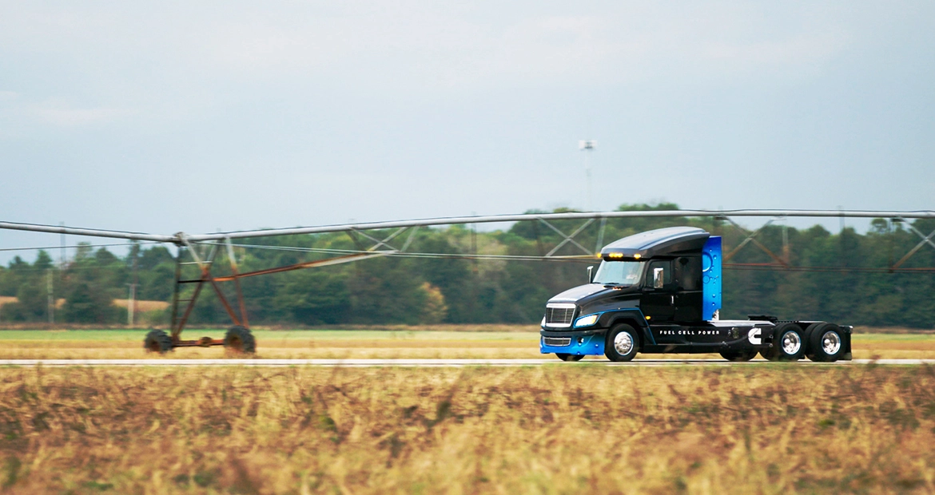
8.
Hydrogen Fuel Cell Electric Trucks…
Have 99% of the payload capacity of diesel.
Refuel at the pump, like diesel
Emit only water vapor
https://www.fch.europa.eu
Path to hydrogen competitiveness: A cost perspective
Notes:
The other, more promising alternative is hydrogen fuel cell electric trucks. These have 99% of the payload capacity of diesel and refuel at the pump, while emitting only water vapour as emissions.

Slide 10

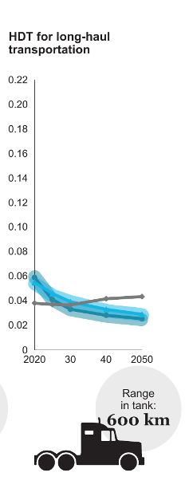

9.
By 2025, hydrogen for long-haul and regional transportation will be cost-competitive with diesel for truck fleet managers.
Notes:
Furthermore, it is estimated that by 2025, hydrogen for long-haul and regional transportation will be cost-competitive with diesel for truck fleet managers.

Slide 11
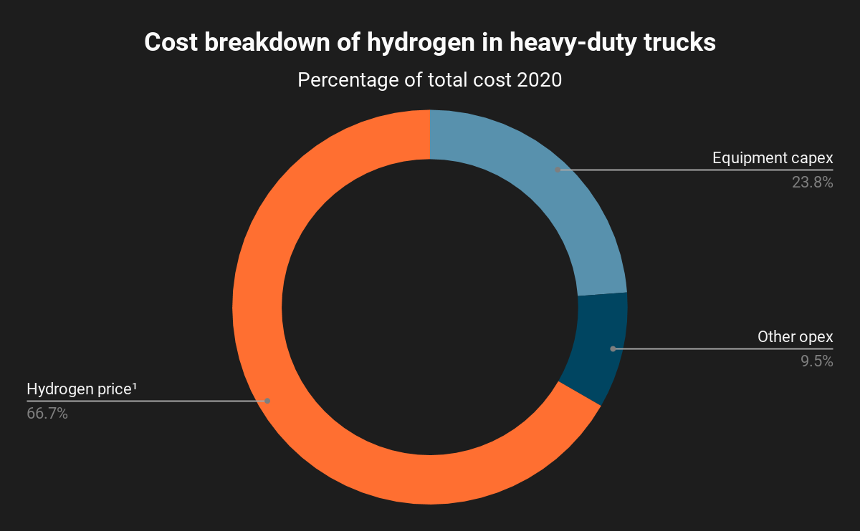
10.
However, the price of hydrogen is currently the main factor preventing them from investing.
1. Assumes 50/50 blend of low-carbon and average renewable hydrogen.
Path to hydrogen competitiveness. A cost perspective, Hydrogen Council, http://www.hydrogencouncil.com. Jan 20, 2020
Notes:
However, the high price of hydrogen is currently the main factor preventing them from investing. As shown on the right, two-thirds of the cost associated with fuel cell trucks is the cost of the hydrogen itself.

Slide 12
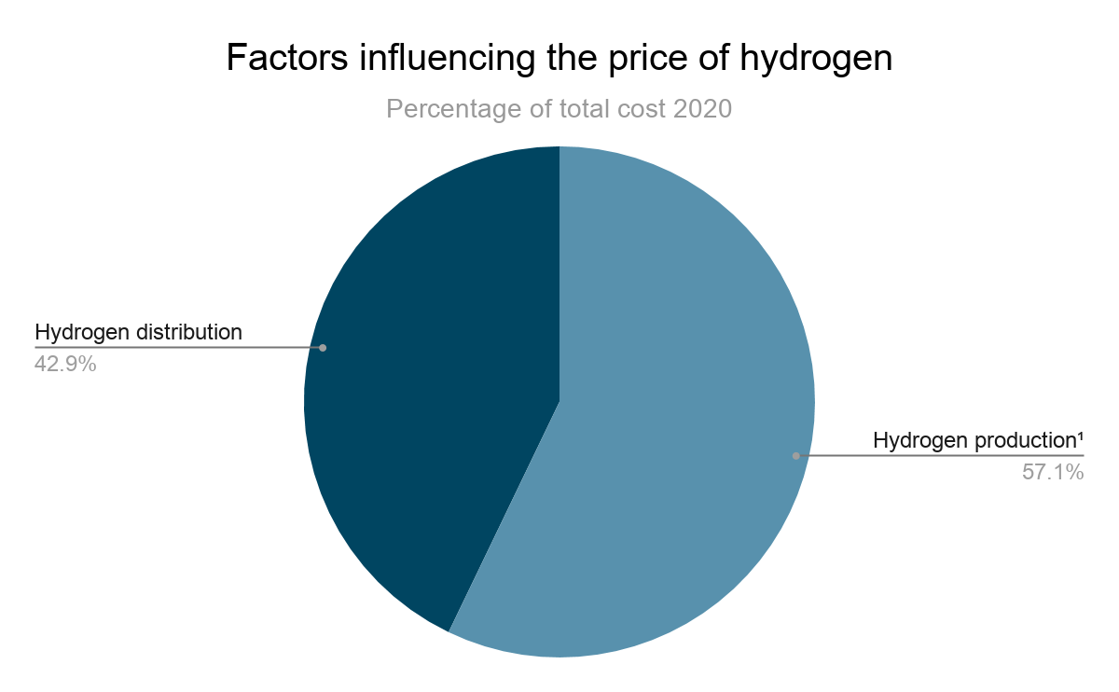
11.
TWO FACTORS
Hydrogen is expensive because of the high cost of H₂ production and distribution.
On-site electrolysis, tank trucks, and pipelines are cost prohibitive.
1. Assumes 50/50 blend of low-carbon and average renewable hydrogen.
Path to hydrogen competitiveness. A cost perspective, Hydrogen Council, http://www.hydrogencouncil.com. Jan 20, 2020
Notes:
Looking at this further, we see that hydrogen is expensive because of the high cost of H2 production and distribution. On site-electrolysis, tank trucks, and pipelines are all cost-prohibitive, and so our plan with our business model is to minimize both of these as much as possible.

Slide 13

12.
OUR SOLUTION
Starfish distribution
Notes:
In our business model we propose the starfish distribution

Slide 14



13.
D
C
B
D
D
C
B
B
C
A
B
B
C
C
D
D
Notes:
Lets consider we have a place called A. This is where our only production center will be and where all the trucks will pass going from one destination to another destination. This is to minimize the cost of production.
We now have one truck that has to go to place C. The circle shows the range that can be covered by truck x. The completely filled tank of truck x covers more than twice the distance of A to C.
In this way the truck can empty its excess of hydrogen in fuel station B before it returns to place A. So there is no external transport needed to transport hydrogen to refuel station B. Of course the truck company gets repaid for the delivered hydrogen. The price difference between bought and sold hydrogen will reflect the available volume at place B.
Now if another truck want to go to place D and twice the distance between A and D can’t be covered by a completly filled tank, truck y has to refill at fuel station B. We can repeat this sytem in different directions to get a starfish like form.

Slide 15
14.
This solution benefits both Shell and truck fleet managers.
SHELL
TRUCK FLEET MANAGERS
Centralized hydrogen production reduces costs.
No need for pipelines or fuel trucks
Lower hydrogen price
Earn money to transport hydrogen
https://www.fhwa.dot.gov/reports/tswstudy/Vol2-Chapter3.pdf
Notes:
There are two big advantages for Shell: the big production center in A reduces due to economics of scale their production costs. Next to that they don't have to pay for the installation of pipes or an external transport company which makes the cost of transport smaller. The truck fleet manager benefits from this system due to the reduced hydrogen price at place B. In addition they can gain extra money by optimizing their transport of hydrogen..

Slide 16
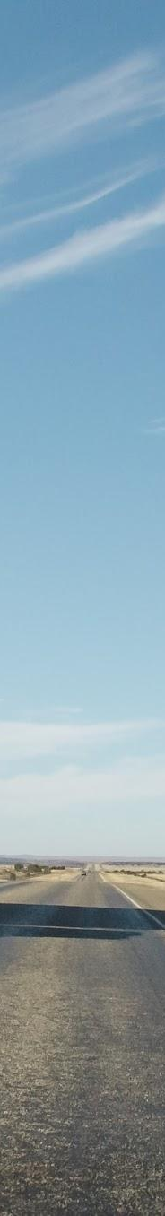
15.
Equip each fuel station with a discharging mechanism.
Develop software to manage distribution.
Determine ideal balance between range and payload capacity.
SOLUTION
“Most trucks and combinations operate at or below the GVW limits because the available space in the truck becomes filled first.”
https://www.fhwa.dot.gov/reports/tswstudy/Vol2-Chapter3.pdf
Notes:
The following steps for Shell are to equip each fuel station with a safe and reliable discharging system. Secondly there should be built a software system for both Shell and the truck fleet manager.
As last point a sensitivity analysis should be executed by both Shell and the fleet truck manager to determine the ideal balance between range and payload. Regarding this last point, we found that most trucks reach faster their volume limit rather than their mass limit

Slide 17

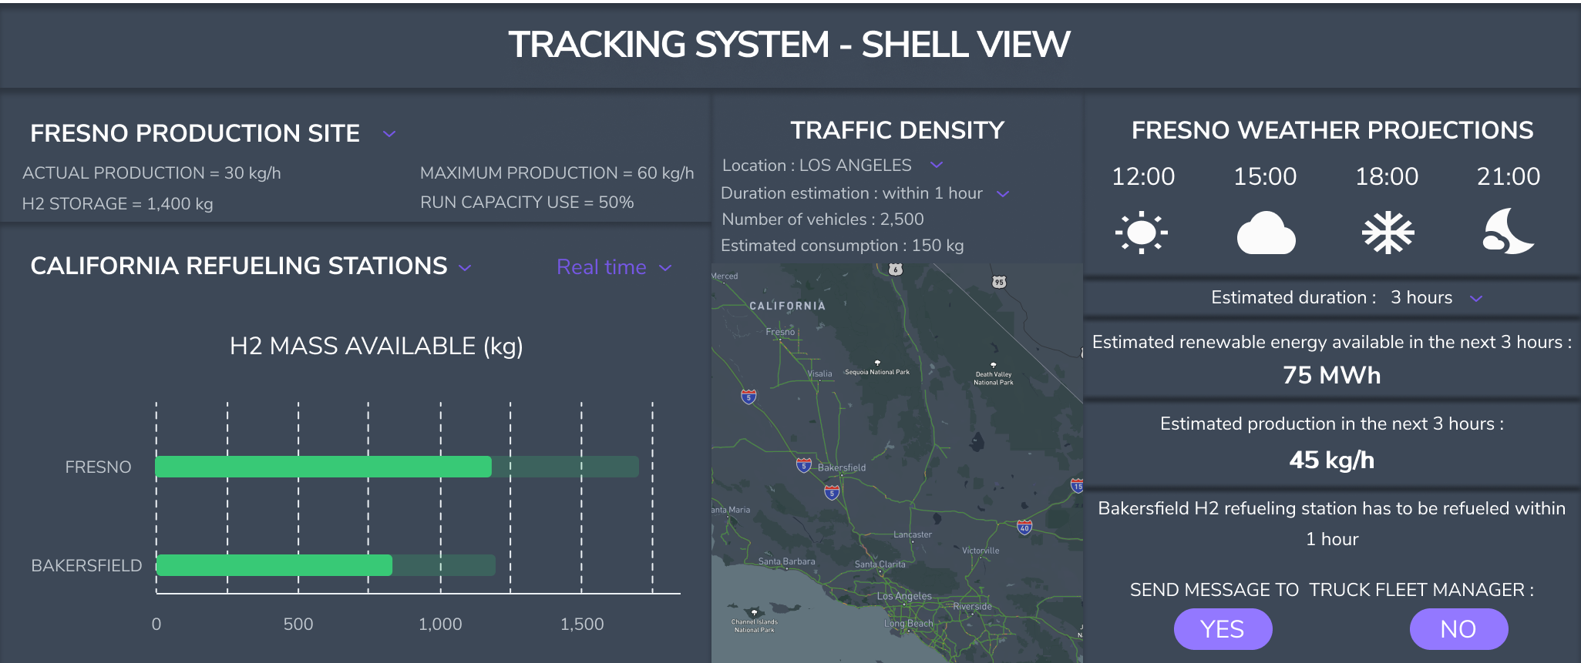

16.
SOFTWARE: SHELL
Automated distribution
Shell will be able to continuously monitor the volume of hydrogen available at each refueling station. They will then be able to change the price of hydrogen at each pump to incentivize trucks to dispense more hydrogen at specific locations.
Notes:
This is how the screen for Shell would look like. Important for Shell is to control the mass of hydrogen available in each fuel station. To act on changes in storage, Shell will change the prices at the fuel stations to give an incentive to the truck fleet managers to dispense their excess of hydrogen.

Slide 18
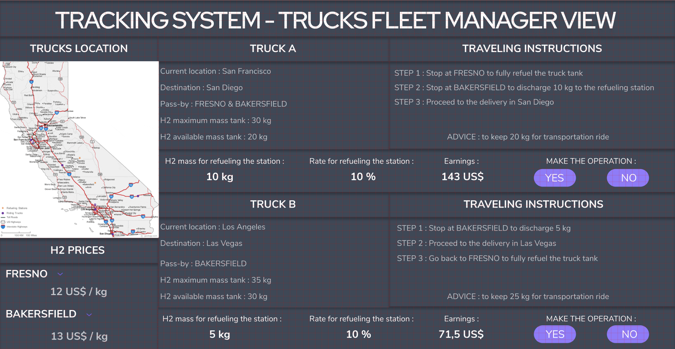

17.
SOFTWARE: TFM
Routing Optimization
The truck fleet managers would be automatically reimbursed based on the volume of hydrogen transported to the peripheral refuelling stations.
Notes:
The screen for the truck fleet owner shows the location of each truck and the different prices at each fuel station. When the incentive is there, they can give their instructions to the truck drivers to optimize their earnings.

Slide 19
18.
It is important to determine the optimal location for the production facility (place A).
Notes:
The software will be used to send the trucks to our refueling stations to deliver hydrogen.
But where will be located the production unit ? Do you remember our starfish model ? This is our point A.
We will produce our green hydrogen thanks to a renewable current source used in the alkalyne electrolysis process.
To achieve this, we need a rough material source, a power source and a market which is ready to take part of the model.

Slide 20
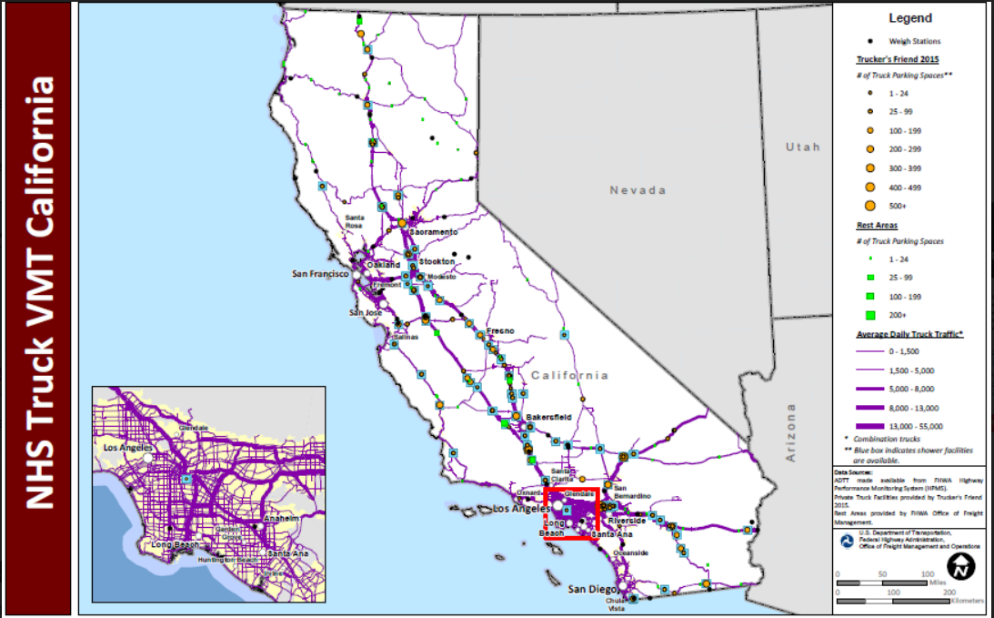
19.
PRODUCTION FACILITY REQUIREMENTS
It must be in a central location.
The central production facility must be located in a central location that can be easily reached by trucks to refuel. Furthermore, it should be situated as close as possible to both San Francisco and Los Angeles so that the trucks can make return trips within their range.
Map of major trucking routes in California. https://ops.fhwa.dot.gov
Notes:
The first thing to look at is the market. Our point A must be located in a central location.
We know that in California the main truck traffic is taking place between San Francisco and Los Angeles. There are two main roads connecting these two cities.
Ideally, the production facility would be located along one of these roads.

Slide 21
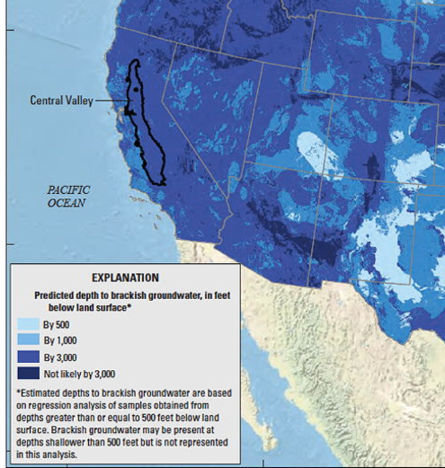
20.
PRODUCTION FACILITY REQUIREMENTS
It must be close to a brackish water source.
The production facility will make use of brackish water for electrolysis. In California, fresh water is scarce and salt water electrolysis is not yet a mature technology. Since brackish water is slightly salinated, it will need to be purified using reverse osmosis.
Estimated depth to brackish water in California. https://water.usgs.gov/ogw/gwrp/brackishgw/study.html
Notes:
What about the rough material ?
We definitely need a water source for our production process.
It can either be seawater or brackish water.
Remember, we are in California where there is a lot of brackish water as you can see on the graph. This is a cheap source of low salinity water which is a requirement for our hydrogen production. Developing the model using this kind of water let us the possibility of expanding the model to other states in America.

Slide 22
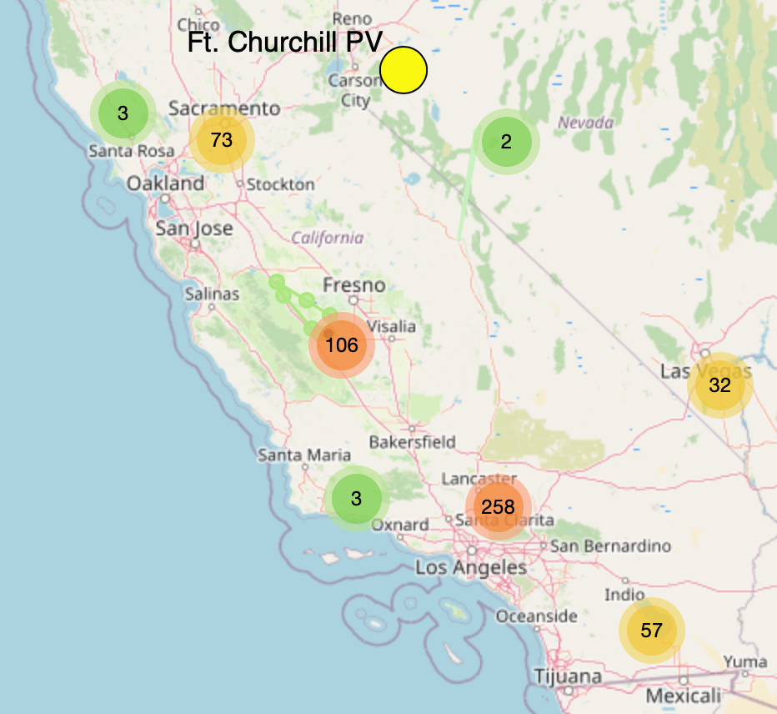
21.
PRODUCTION FACILITY REQUIREMENTS
It must be close to an inexpensive power source.
Solar energy is currently the least expensive renewable energy source on the market. In our proposal, Shell would purchase the required energy from a pre-existing solar facility.
Map of solar stations in California. https://www.cccarto.com/calsolar
Notes:
The last thing we have take care about is the power source.
The power source will define our production cost. However it needs to be cheap. So why not using solar energy as a current source for our production unit ?
We can see on this map that the two largest solar farms in california are near Fresno and Los Angeles.
This allows us to discuss with the energy producer to get lower price which will decrease the production cost again.

Slide 23
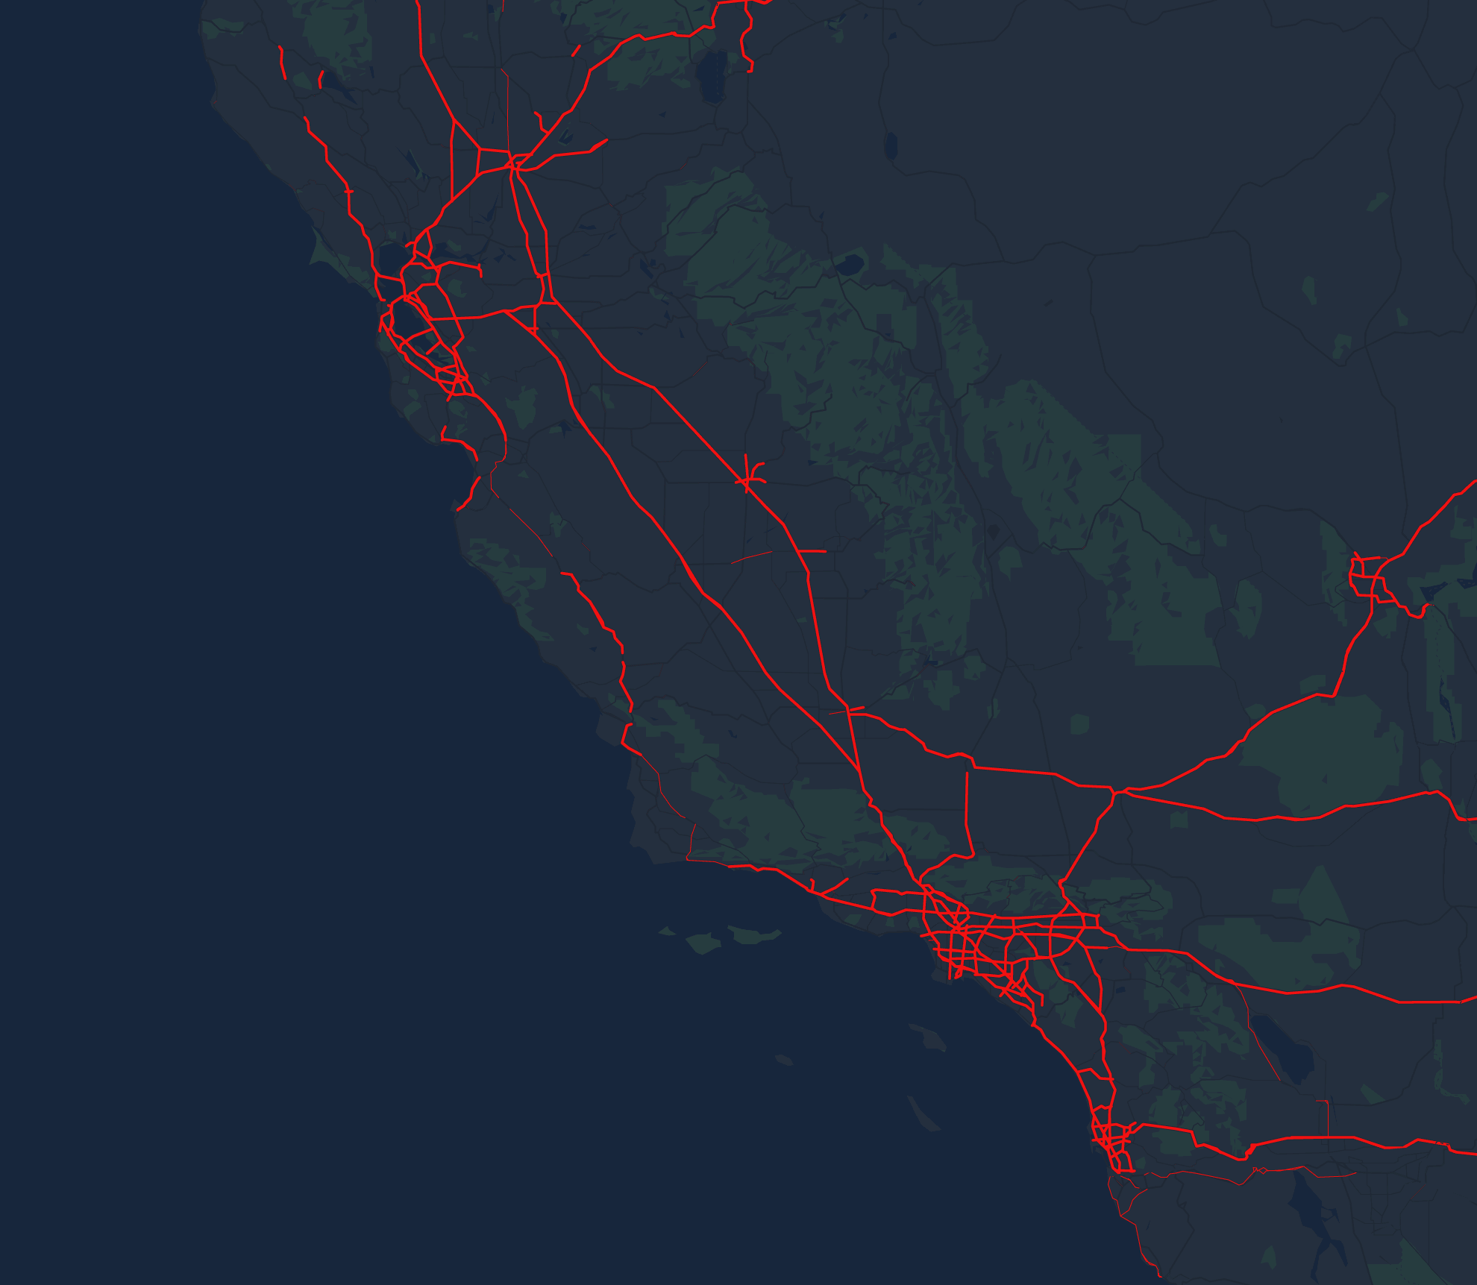
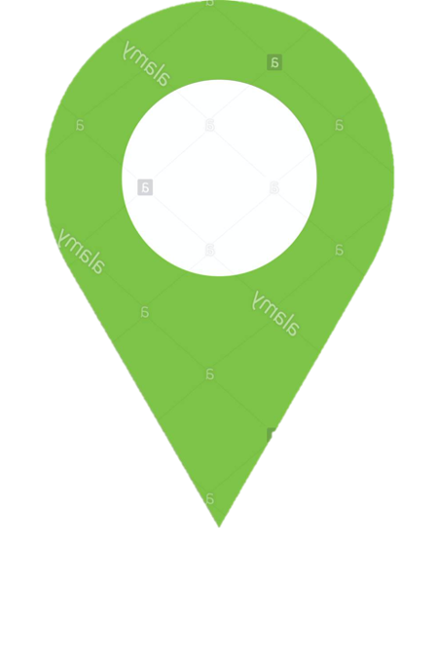

22.
SACRAMENTO
C
The hydrogen production facilities will be located in Fresno, California.
C
SAN FRANCISCO
A
FRESNO
PROXIMITY
Fresno is located 209 miles from San Francisco and 285 miles from Los Angeles, both less than half of an FCEV truck’s range.
B
BAKERSFIELD
POWER
Fresno is within close proximity of a large density of solar projects.
C
LOS ANGELES
WASTEWATER TREATMENT PLANT
The Fresno-Clovis Wastewater Facility needs oxygen for the microorganisms which purify the water. Excess O₂ produced by electrolysis could be sold to them.
SAN DIEGO
D
Key destinations
Peripheral refueling station
https://watereuse.org/wp-content/uploads/2015/09/Presentation-Wastewater-Management-Division-January-2014.pdf
Notes:
As a result of all these information, the hydrogen production facilities will be located in Fresno. This is our place A. There is no competition at this place, only one refueling station does today exist.
With a 1,000 km trucks, we can reach any destination putting the refueling station in Bakersfield so the model we are developing is working.
As a part of the reduction of investment costs, the selling of the oxygen produced in our electrolysis process to the WWTP of Fresno can be a major advantage.

Slide 24
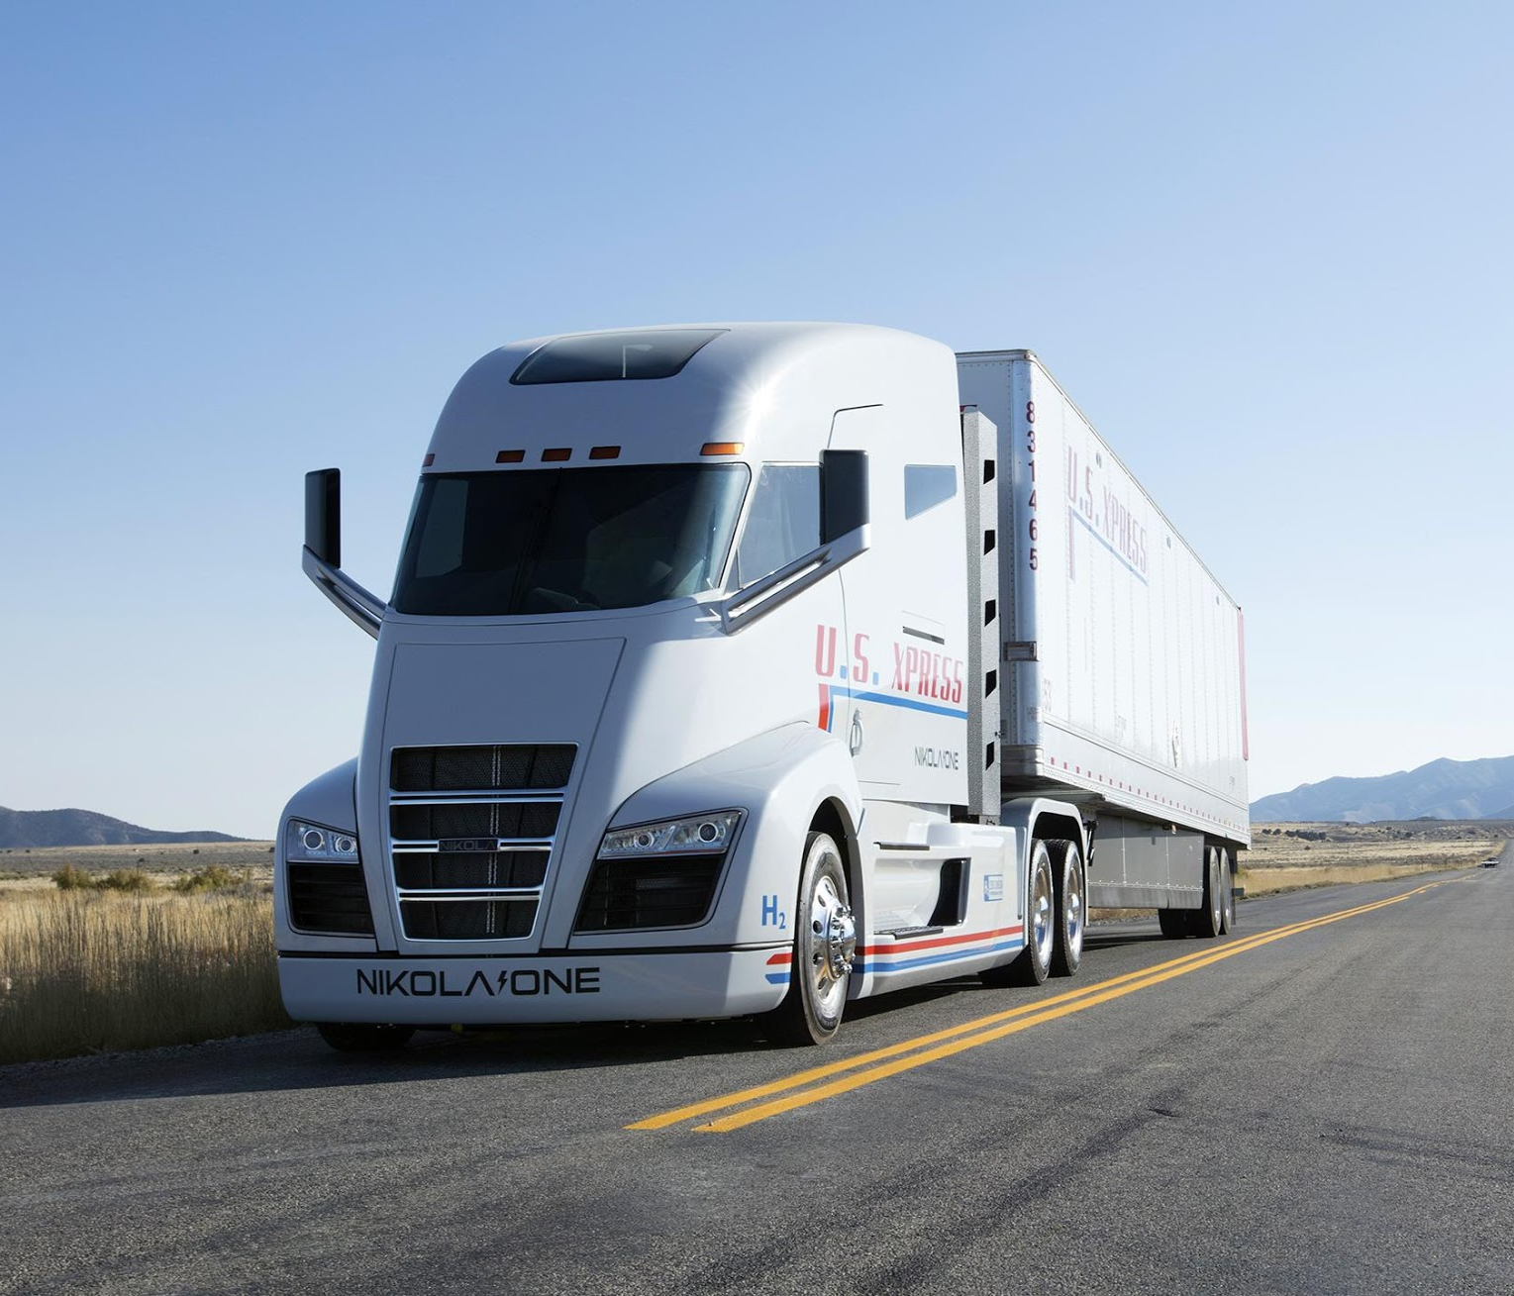
23.
RANGE
The Nikola One and Two have a range of 800 — 1200 km. This is enough to reach the following cities from Fresno:
Destination | Distance (km) | Truck range (km)
 |  | 800 | 900 | 1000
Sacramento | 272
San Francisco | 299
San Jose | 288
Long Beach | 389
San Diego | 368
Las Vegas | 459
Within range
Out of range
https://nikolamotor.com/one
Notes:
For example, this Nikola one and Two have a range of 800 - 1200 km. With our production facility in Fresno and a refueling station in Bakersfield, return trips to all of the major cities in the region could be performed easily, with the exception of Las Vegas, which could reached only with a range of 1000 km. This, however is possible.

Slide 25
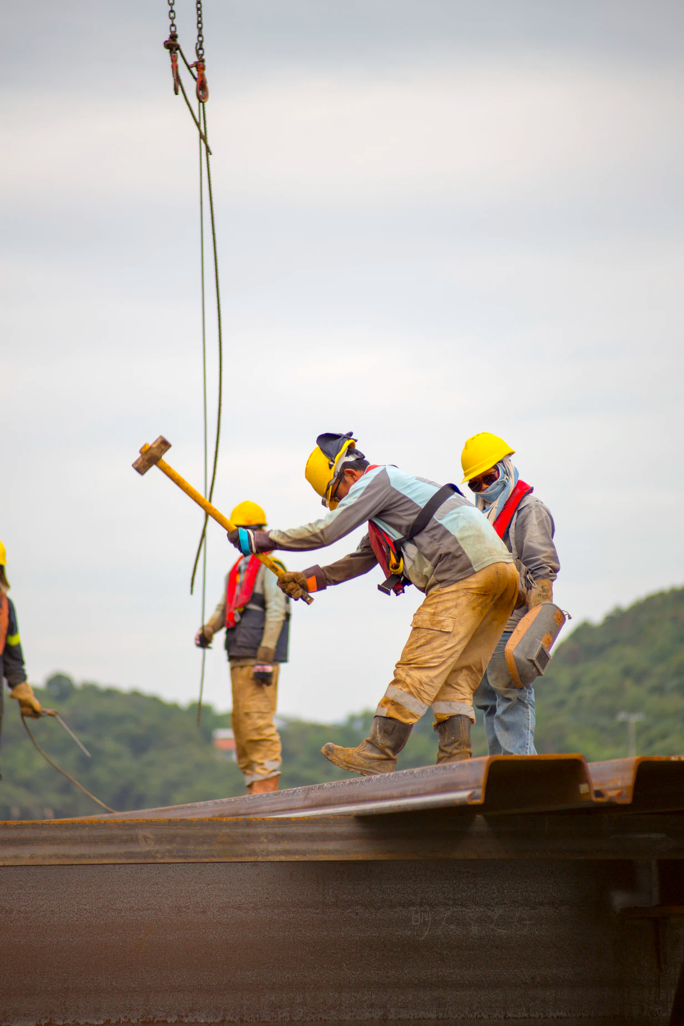
24.
Impact
Notes:
So now for the final section of this presentation we’re going to discuss the various impacts of enacting the proposed model.

Slide 26
25.
Economics
How much will it cost?
50
$860/kW
10 kg H₂/100km
Trucks
Capex alkaline electrolyser
Consumption rate
$50M
Capex investment for production facility and fuel stations
Current status of water electrolysis for energy storage, grid balancing and sector coupling via power-to-gas and power-to-liquids: A review.
Notes:
Assuming we have a fleet of 50 trucks, our alkaline electrolyser requires a capital expenditure of $860 per kilowatt, and our trucks consume 10 kilograms of hydrogen gas for every 100 kilometers, The cost of the capital investment for our hydrogen production facility, as well as the required fuel stations will result to be about 50 million dollars.
All our sources:
Current status of water electrolysis for energy storage, grid balancing and sector coupling via power-to-gas and power-to-liquids: A review
https://www.fch.europa.eu/sites/default/files/171121_FCH2JU_Application-Package_WG1_Heavy%20duty%20trucks%20%28ID%202910560%29%20%28ID%202911646%29.pdf

Slide 27
26.
Economics
How much will it save in transport?
$1 /kg H₂
1,000 km
Saved by novel hydrogen distribution model centered at Fresno.
Truck Range
$426,000
Annual profit distributed between Shell and truck fleet manager.
Path to hydrogen competitiveness: A cost perspective
Notes:
Now to investigate the savings. With a centralized hydrogen production facility in Fresno, and effective utilization of the truck fleet as distributers, about 1 dollar will be saved in distribution costs for every kilogram of hydrogen. These savings will be distributed between Shell and the truck fleet manager.
If you multiply the savings per kilogram by the amount of excess hydrogen that is transported works out to be $426,000 in savings per year.
Path to hydrogen competitiveness: A cost perspective
Normal price of H2 is 1$/kg in our system no money is getting outside the loop, so SHELL will redistribute the earned amount with the TFM

Slide 28

27.
A new technology without job loss.
Production facility and refueling stations to build
Production facility to operate
Software development in California
Notes:
Another impact of this model is the multitude of jobs created, ranging from software development, to water treatment, to facility construction. Moreover these jobs will be domestic, providing work and stimulus directly to the californian state.
Job creation (H2 production unit to build, refueling stations, software to develop...) + software making + truck drivers job kept
Change in technology doesn’t come with job losses, on the contrary

Slide 29
28.
Roadmap
Construct distribution center and peripheral refueling stations.
Establish capacity of fifty trucks.
Implement the discharge mechanism
Expand refueling network.
Investigate other power sources
Expand the system
Retrofit existing diesel trucks to use Internal Combustion Assistance.
An initial fleet of heavy-duty trucks will test the system within a limited range.
Expand it to a maximum of existing refueling stations.
Construct additional refueling stations and distribution centers to support larger fleets.
Using wind as a current source during the night would decrease the production costs as the electricity price is lower when demand is low.
Consider other projects such as storing H₂ in the salt dome discovered in Delta, Utah.
Notes:
Since mass change cannot be enacted all at once, we have hypothesized a roadmap with which you could gradually transition Heavy duty trucking to hydrogen fuels in the US.
First steps would include the construction of a distribution center, and an introduction of hydrogen as fuel to truckers. Retrofitting existing trucks to use hydrogen combustion creates a demand for hydrogen without requiring such a large investment for trucking companies. Eventually the fleet will switch over to hydrogen fuel cells instead of combustion.
From this point, a fleet will be established and the range and efficiency of these trucks will be investigated in order to enact the next step, the starfish system.
The starfish system will be properly implemented as truck drivers are enticed to discharge their excess fuel to sustain the network.
Though the model is almost fully enacted, that does not mean there isn’t much room for growth. From this point alternative power sources can be investigated such as taking wind power from off peak hours for potentially a lower price.
Finally the model can be expanded past california and other hydrogen based projects can be considered, such as the possibility of storing hydrogen in the salt dome discovered in Delta, Utah.

Slide 30

29.
This is the future.
D
Thank you for listening to our presentation, it truly means a lot to us. If you have any questions, please don’t hesitate to let us know.
D
C
D
C
C
D
CONTACT
B
arw.koen@gmail.com
gaetan.vervaele@hotmail.com
clbolongaro01@gmail.com
william.navarro@gmx.com
All the best.
C
B
B
B
A
Notes:
The future is almost upon us, and everyday it becomes more clear that if we are to continue to thrive, we must do so by innovation.
Our team believes that the future we all strive towards can be realized in part by unleashing the potential of hydrogen as a fuel.
Thank you to the Stanford Cleantech Challenge for giving us the opportunity to share our ideas, and come together from different sides of the world.
If you have any questions about this presentation don’t hesitate to ask via our emails listed above.
Lets consider we have a place called A. This is where our only production center will be. This is to minimize the cost regarding economics of scale. We now have a truck x who has to go to place C. The completely filled tank of truck x covers more than twice the distance of A to C. In this way C can empty its excess of hydrogen in fuel station B before it returns to place A. Of course the truck company gets repaid for the delivered hydrogen. The price difference between bought and sold hydrogen will reflect the available volume at place B. Now if truck y want to go to place D and twice the distance between A and D can’t be covered by a completly filled tank, truck y has to refill at fuel station B. It becomes directly clear that the trucks like truck x have to transport enough hydrogen to foresee trucks like truck y for enough hydrogen to reach place D and return to place A. Therefore then density of the routes play an important role where to put our places A and B. We can repeat this sytem in different directions to get a starfish like form.

Slide 31
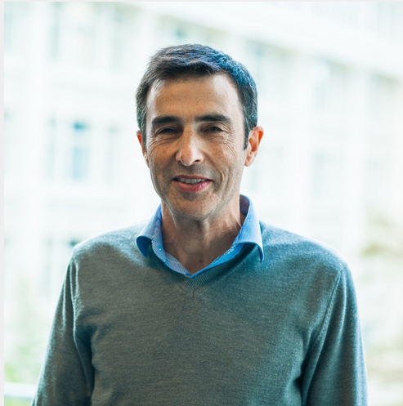

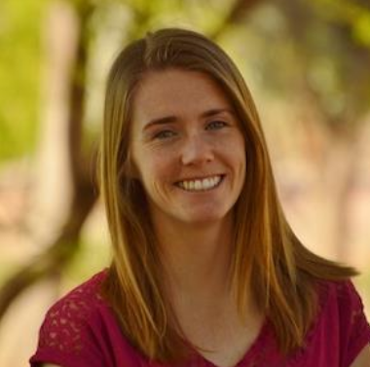

30.
SOURCES
Experts Consulted
Daniel Friedmann
Nicolas Astier
Chairman of Carbon Engineering
Stanford Precourt Institute for Energy
McKenzie Hubert
Fabrice Mauléon
Ph.D. Candidate - Chemical Engineering at Stanford
Expert in innovation and digital technologies.
Although we would like to stress that all ideas and work were our own, we are incredibly thankful for their constructive criticism and support.

Slide 32
Appendix
Notes:
An environmentally-friendly way of producing H2 is the alkalyne electrolysis. This process uses a current source. Our goal is to produce green H2, which means that we need a power source that is renewable.
Added to this challenge we need a huge quantity of water that is easy to process.
Over all, we need a demanding market because without this any technology is unusable.

Slide 33
Calculations
Assumptions | Value
# Trucks | 50
Fuel consumption per truck (kg H2/100km) | 10
Yearly average mileage for a class 8 truck (km/year) | 104607.1
Cost of solar electricity ($/kWh) | 0.085
Please see the Estimation of Costs spreadsheet for details.

Slide 34
Calculations
Electrolyzer Technology | Alkaline
CAPEX (US$/kW) | 860.2
OPEX (US$/kW) | 17.2
Efficiency (kWh of electricity/kg of H2) | 0.64
Efficiency (MJ/kg of H2) | 2.304
Volumetric mass H2 (Patm) (kg/m3) | 0.08988
Molar mass H2 (g/mol) | 2.016
Volumetric mass 02 (Patm) (kg/m3) | 1.35
Molar mass O2 (g/mol) | 32
Electrolysis technology
Although proton exchange electrolysis is slightly more efficient, we chose to use alkaline electrolysis because it is a more mature technology and because a >50 MW PEM facility would be unprecedented.
Please see the Estimation of Costs spreadsheet for details.
Adolf, J., et al. "Shell hydrogen study energy of the future? Sustainable mobility through fuel cells and h2." Shell, Hamburg (2017).
Future cost and performance of water electrolysis: An expert elicitation study
Notes:
Need a better justification for PEM

Slide 35
Calculations
Production Facility | Fresno, California
Produced hydrogen per year (kg H2 / year) | 523035.5
Energy required per year (MJ/year) | 1205073.792
Power required (MW) | 55.02620055
Cost production site (dollars) | 47,334,366.06
Cost production site (million dollars) | 47.33
Given the above assumptions, the production facility is expected to cost $47 million dollars and consume 1205 GJ (335 GWh) of energy annually.
Please see the Estimation of Costs spreadsheet for details.
Notes:
Need a better justification for PEM

Slide 36
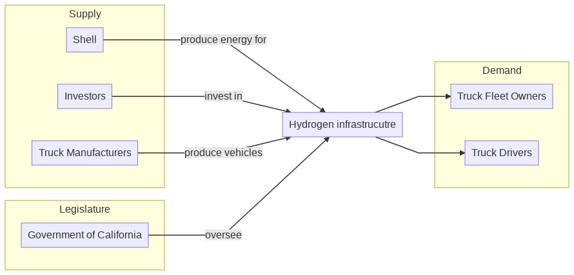
Stakeholders
Notes:
Before we go further in to details, we should clarify who the stakeholders are in this market. At the production side, there is the producer of the hydrogen (in this case Shell) and the manufacturer of the heavy load trucks. At the demand side, there is the driver who owns his own truck or the heavy fleet truck manager which own multiple trucks and contracts truck drivers. 90% of the truck drivers work for a fleet truck company. That is an important number because it makes investments in new trucks easier to bear.
Code for diagram:
graph LR
subgraph Supply
m[Truck Manufacturers]
sh["Shell"]
Investors
end
sh -->|produce energy for|s[Hydrogen infrastrucutre]
Investors -->|invest in| s
m -->|produce vehicles| s
subgraph Demand
o[Truck Fleet Owners]
d[Truck Drivers]
end
s --> o
s --> d
subgraph Legislature
g[Government of California]
end
g -->|oversee|s

Slide 37
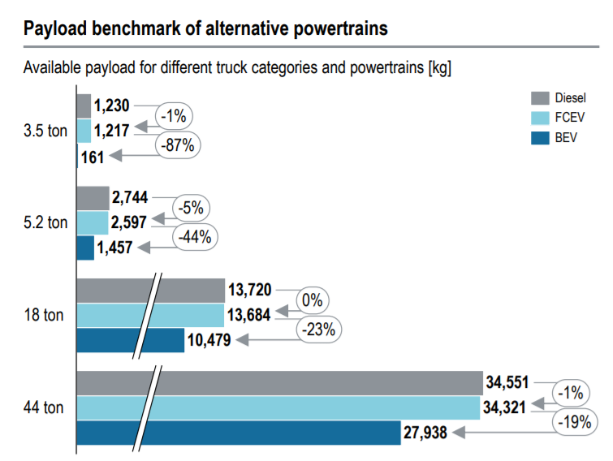
Payload capacity of different powertrains
https://www.fch.europa.eu
Notes:
To electrify heavy load trucks, there are two options: battery or fuel cell. Heavy load trucks need long-range capabilities which necessitates very heavy batteries which implies a high payload loss. In addition the long charging time for batteries gives a disadvantage in pay up time. Certainly for heavy load trucks which make a lot of kilometers per year, is this a real disadvantage. (source picture: https://www.fch.europa.eu/sites/default/files/171121_FCH2JU_Application-Package_WG1_Heavy%20duty%20trucks%20%28ID%202910560%29%20%28ID%202911646%29.pdf)

Slide 38
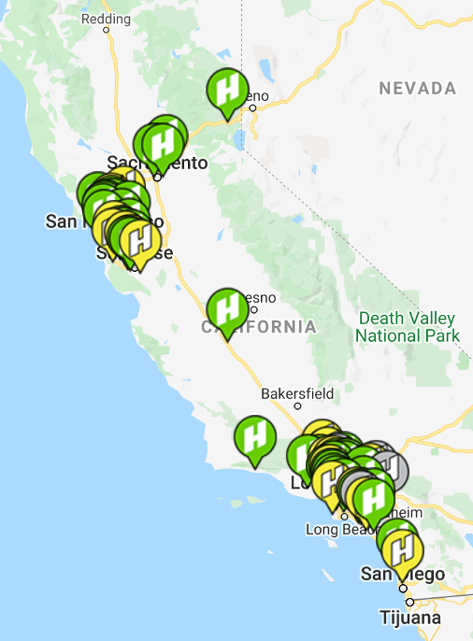
Current H₂ fuel stations in CA
Many of these hydrogen fuel stations could be retrofitted to support discharging. Specifically, those located near ports would be especially valuable since trucks must stop regardless to unload, and could conveniently discharge excess hydrogen.
https://cafcp.org/stationmap

Slide 39
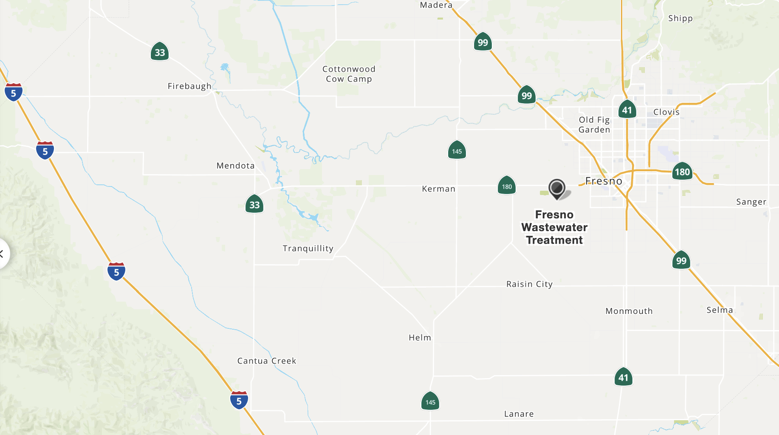
Wastewater treatment
Large volumes of O₂ are produced as a byproduct of hydrolysis. This oxygen could be sold to the Fresno Wastewater Treatment facility, who require large amounts of oxygen for the microorganisms they use to break down waste.
https://www.fresno.gov/publicutilities/wp-content/uploads/sites/16/2016/11/Collection-System-Master-Plan.pdf
Notes:
Process of ethylene oxyde formation + enrichment in the refineries + blast furnace in metallurgic industry

Slide 40
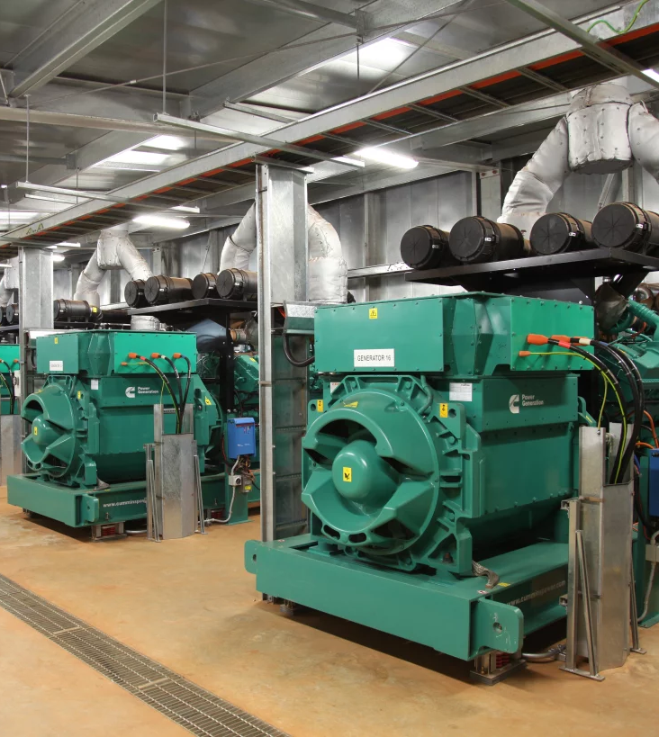
Hydrogen diesel retrofit
HyTech Power has developed an Internal Combustion Assistance (ICA) technology to retrofit 9-18 L diesel engines.
Improves fuel efficiency by up to 30 percent.
Composed of an electrolyzer, an injection system and a timing controller.
Alternative fuel retrofit systems regulated by the California Air Resources Board https://ww2.arb.ca.gov/alternative-fuel-retrofit-systems-aftermarket
Could be used as a transition technology towards FCEVs.
https://www.hytechpower.com/products

